Slide 1

DEEPFAKE FACE DETECTION
P VENKATA VISHNU VARDHAN
192210520
COMPUTER SCIENCE AND ENGINEERING

Slide 2
Problem & Solution
Problem
Deepfake technology enables AI-generated images to manipulate reality with high precision.
Leads to misinformation, identity fraud, and security risks.
Social media platforms, businesses, and government agencies struggle to verify authenticity.
Traditional detection methods are ineffective against advanced deepfake techniques.
Manipulated images undermine public trust and pose risks in journalism, cybersecurity, and law enforcement.
Lack of reliable detection leads to reputational, legal, and financial consequences.
Solution
AI-driven Deep Fake Photo Detection verifies digital images in real time.
Uses Deep learning to detect inconsistencies, analyze metadata, and examine pixel artifacts.
Enables businesses, media, and security agencies to prevent misinformation.
Seamlessly integrates with social media, corporate security, and law enforcement databases.
Continuously updates to adapt to evolving deepfake techniques for high accuracy.
Restores trust, prevents fraud, and enhances online security.

Slide 3
Product Domain Study
SUMMARY
A deepfake face detection system is a specialized AI-driven solution designed to identify and prevent the use of manipulated or synthetic facial images in real-time. It works by analyzing facial features, detecting inconsistencies, and verifying authenticity using advanced machine learning algorithms. The system ensures that only genuine human faces are recognized, preventing fraudulent activities such as identity theft, misinformation, and unauthorized access. This feature is particularly useful in security-sensitive applications, including identity verification, digital forensics, and content moderation. By reliably detecting deepfake images, the system enhances trust, minimizes deception, and safeguards users and organizations from potential threats.
Article Link:
https://ieeexplore.ieee.org/abstract/document/9712265/
.

Slide 4

Problem Statement
Rise of Deep Fakes:
The increasing prevalence of deep fakes and fake images poses significant challenges to trust and authenticity in the digital world. Misinformation can spread rapidly, impacting public opinion, reputation, and even personal safety.
Misinformation Risks:
Fake images can spread misinformation, impacting public opinion, reputations, and safety.
Detection Struggles:
Current detection methods lag behind advancements in deepfake technology.
hms to distinguish real from fake images with minimal errors.

Slide 5
My Role & Responsibilities
My Role
AI Engineer focused on developing a robust deepfake and fake image detection system.
My Responsibilities
Researching and implementing AI algorithms, training and evaluating the detection model, ensuring accuracy and reliability.
Researching AI Algorithms:
Explore and implement cutting-edge AI techniques and algorithms for deep face detection.
Model Training:
Train detection models using large and diverse datasets to recognize fake images accurately.
Evaluation:
Continuously evaluate the performance of detection models, using metrics like precision, recall, and F1-score to ensure high reliability.
Ensuring Accuracy:
Focus on minimizing false positives and negatives to maintain the system's effectiveness in real-world applications.

Slide 6
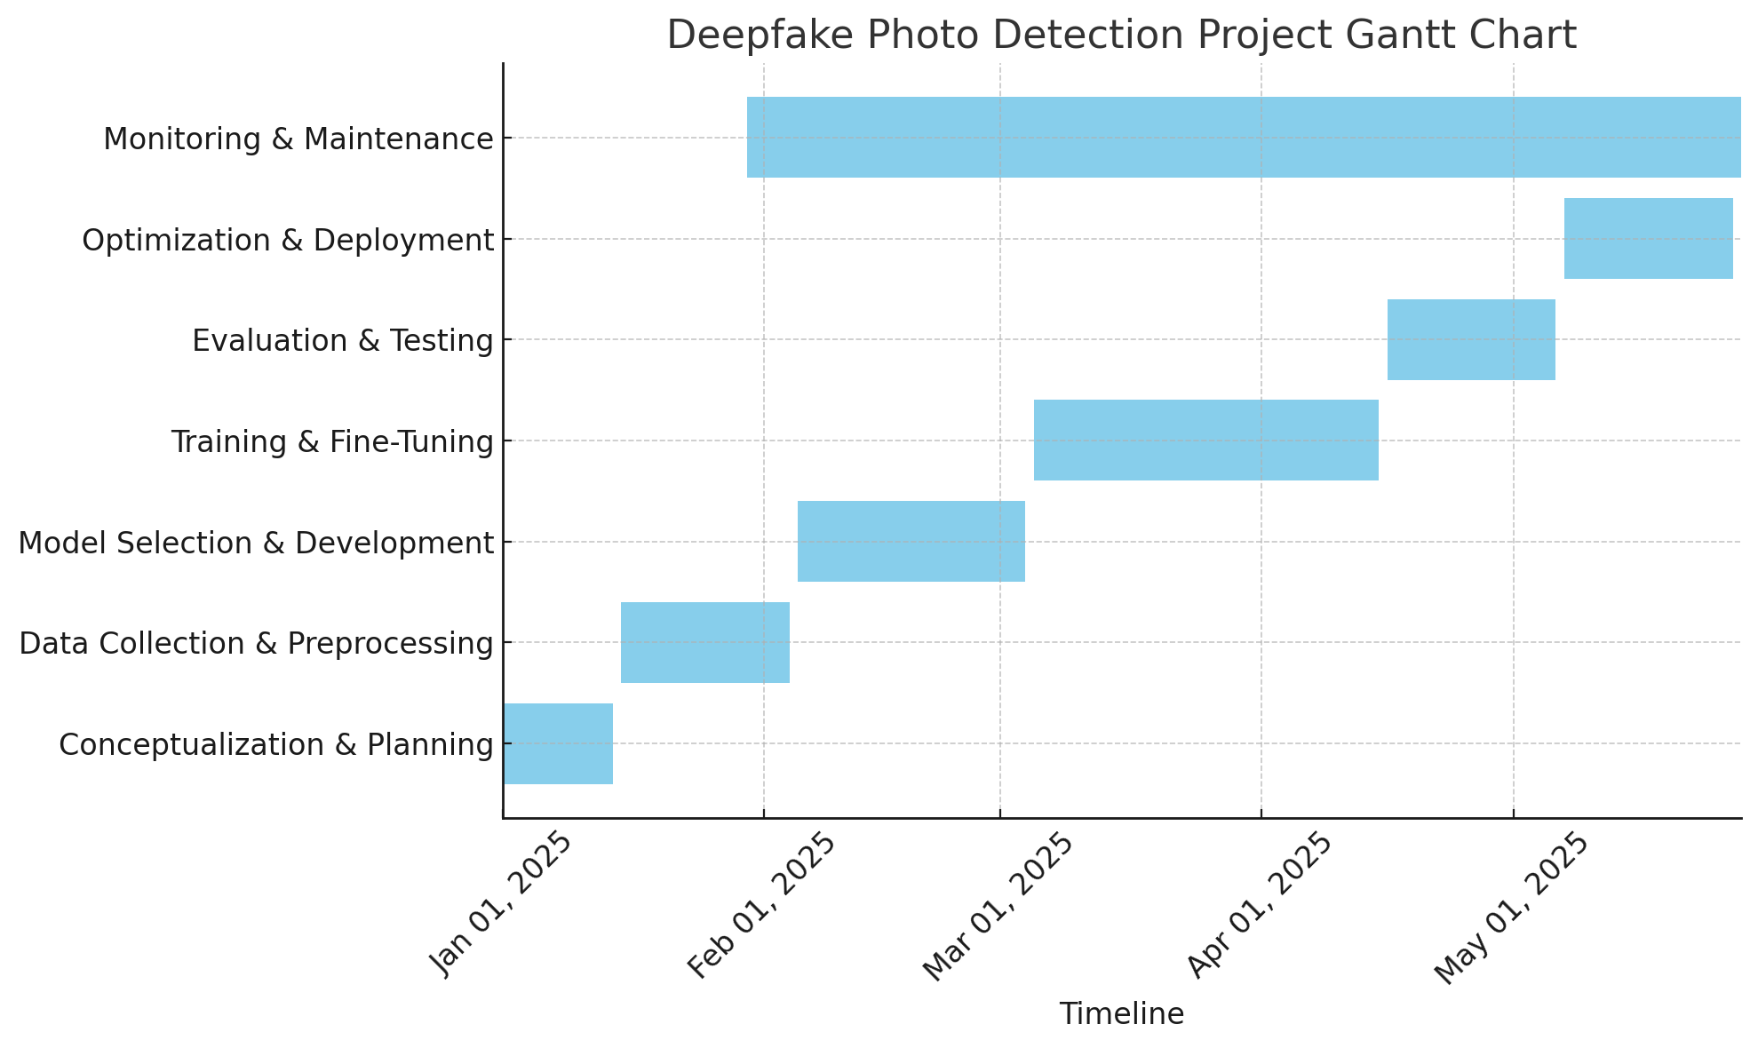
Gnnat chat
1
Research & Analysis
Gather data, explore existing detection methods, analyze deepfake and fake image characteristics.
2
Model Development
Design and train a deep learning model to identify specific features of deep fakes and fake images.
3
Testing & Evaluation
Evaluate the model's performance, adjust parameters, improve accuracy, and build a robust detection system.
4
Deployment & Integration
Develop a user-friendly interface, integrate the model into existing platforms, and ensure accessibility for various users.

Slide 7
Project Timeline
Week 1 - Ideation: Define project goals, scope, and key performance metrics.
Week 2 - Ideation: Research current deepfake detection trends and challenges.
Week 3 - Research: Study state-of-the-art detection algorithms and datasets.
Week 4 - Research: Explore transfer learning and anomaly detection approaches.
Week 5 - Design: Design system architecture and choose development tools.
Week 6 - Design: Plan data collection, augmentation, and model pipeline.
Week 7 - Development: Implement pre-processing and feature extraction methods.
Week 8 - Development: Develop and train the deep fake detection models.
Week 9 - Development: Fine-tune models and experiment with hybrid approaches.
Week 10 - Testing: Test models with cross-validation and evaluate performance.
Week 11 - Testing: Perform error analysis and adjust the model for accuracy.
Week 12 - Deployment: Deploy the model to production and set up monitoring.
Week 13 - Deployment: Integrate the model with the user interface and update as needed.

Slide 8

Understanding The User
User Persona 01: The Concerned Social Media User
Name: Emily Johnson Age: 28 Occupation: Marketing Specialist Tech Proficiency: Moderate
Goals & Needs:
Wants to verify the authenticity of images shared on social media.
Concerned about misinformation and manipulated content.
Prefers an easy-to-use tool that quickly detects deep fakes.
Pain Points:
Lacks technical expertise to manually verify images.
Struggles with distinguishing real vs. fake content.
Worries about privacy and data security.

Slide 9

User Persona 02: The Digital Forensics Analyst
Name: Daniel Carter Age: 35 Occupation: Cybersecurity Analyst Tech Proficiency: Expert
Goals & Needs:
Needs advanced deep face detection tools for investigations.
Requires detailed metadata and AI-based analysis.
Wants integration with forensic software and API access.
Pain Points:
Many detection tools lack transparency in results.
Needs a way to detect complex AI-generated alterations.
Requires high accuracy and minimal false positives.

Slide 10
User Journey Map
Stage | User Action | User Emotion | Pain Points | Opportunities
Awareness | Learns about deepfake risks through news or personal experiences. | Concerned, cautious | Lack of knowledge about deepfake detection tools. | Educate users on deepfake threats and solutions.
Consideration | Researches deepfake detection tools online. | Curious, skeptical | Uncertainty about accuracy and reliability of tools. | Provide clear information, case studies, and demos.
Decision | Chooses a deepfake detection system and signs up. | Hopeful, expectant | Concerns about ease of use, cost, and effectiveness. | Offer free trials, simple onboarding, and testimonials.
Usage | Uploads or streams content for deepfake detection. | Engaged, alert | Potential false positives/negatives, processing time. | Improve AI accuracy, provide real-time feedback.
Feedback & Trust | Evaluates results, shares experience with others. | Satisfied or frustrated | Inconsistencies in detection, lack of customer support. | Provide clear explanations, continuous updates, and support.
Retention & Advocacy | Continues using the tool, recommends to others. | Confident, secure | Needs ongoing trust in the system’s accuracy. | Regular updates, community engagement, loyalty rewards.

Slide 11
Competition Analysis
Feature | Competitor A | Competitor B | Competitor C | Your System
Detection Accuracy | 90%+ | 85%+ | 80%+ | TBD (Testing)
Confidence Score | % (Bar) | Text/Graphical | Text Only | % (Visual + Text)
Heatmap/Visual Feedback | No | Yes | Yes | Yes (Interactive)
Real-time Detection | Yes | Yes | No | Yes
Media Supported | Video, Image | Video Only | Image Only | Video, Image
Report Generation | PDF, CSV | CSV | PDF | PDF, CSV
UI | Basic | Advanced | Basic | Clean, Intuitive
Pricing | Subscription-based | One-time License | Free (Limitations) | Subscription-based
Platform Availability | Web, Windows, Mac | Web Only | Windows Only | Web, Mobile (Planned)
API Integration | Yes | No | Yes | Yes

Slide 12
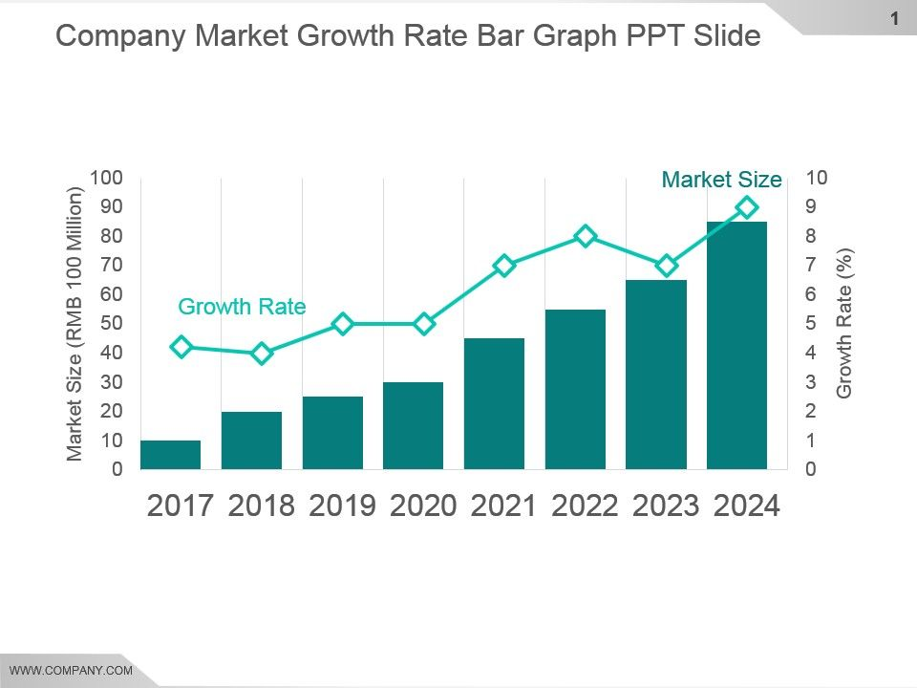
Business Potential,Gap Analysis,Growth Rate & Market Size graph

Slide 13
User Pain Points
PAIN POINTS
Pain Point 01: Accuracy
Issue: Many existing deepfake detection systems struggle to accurately detect highly sophisticated deepfakes, especially those created with advanced AI tools.
Impact: False negatives or missed detections can lead to security vulnerabilities and misinformation spread.
Pain Point 02: Real-time Detection
Issue: Lack of solutions that can analyze deepfakes in real-time, which is essential for applications like live streaming or video conferencing.
Impact: Delays in detection make it harder to act quickly and prevent harm during live broadcasts.
Pain Point 03: Scalability and Platform Generalization
Issue: Deepfake detection models often perform poorly across different platforms (e.g., social media, news outlets), and they may struggle to handle large volumes of content.
Impact: Inconsistent detection results and inability to process high volumes of media efficiently make it difficult for businesses to implement reliable detection at scale.

Slide 14
Rapid Prototyping – Ideation
Rapid prototyping:
Rapid prototyping is an iterative process used to quickly design, develop, and test ideas before full implementation. It helps refine concepts, detect issues early, and improve efficiency.
Process Diagram
Visualize the core steps involved in detecting fake images and deep fakes
.
Flow Diagram
Outline the flow of data through the system, from image input to detection output.
Sketches Drawings
Explore potential visual elements for the user interface and user experience.

Slide 15
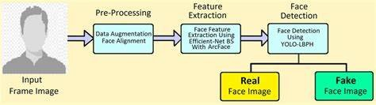
Process Diagram
Upload Media
Users upload the video or image they want to analyze.
Analyze Content
The tool uses advanced algorithms to examine the media for signs of manipulation.
Generate Report
The tool produces a report indicating the probability of a deepfake, with supporting evidence.

Slide 16
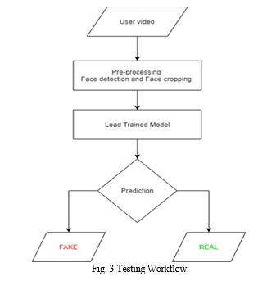
Flow Diagram no
Image Acquisition
The system receives an image as input.
Feature Extraction
The image is analyzed for telltale signs of manipulation.
Classification
The system determines whether the image is authentic or deepfake.
Decision Making
The results are presented, indicating whether the image is real or fake.

Slide 17
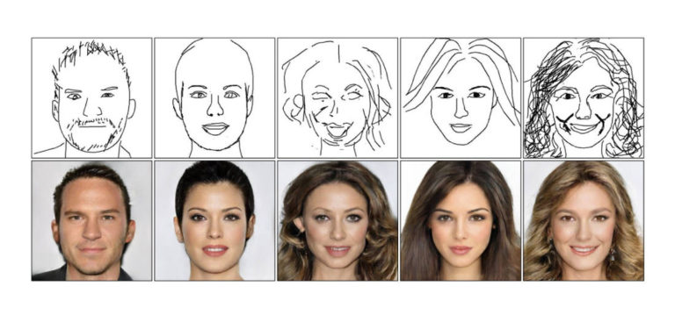
Sketches Drawings
Sketches can be used to represent the user interface or the architecture of the system:
UI Sketch:
A simple dashboard displaying the real-time results of deepfake detection (e.g., a video feed with a "Real" or "Fake" label).
Tools for users to upload media for analysis.
System Architecture:
A diagram showing the components involved in the detection pipeline, like a client (UI), backend server (processing), and model storage.

Slide 18

figma link:
https://www.figma.com/design/RmdJCFjbV39ytg9fPfG8bU/DEEPFake?node-id=0-1&p=f&t=8NTgS98TG8NDlvUf-0
Mockups - Low Fidelity (Convergence)
1
Ideation Alternatives
2
Iterations/Learnings
Compare different design approaches, considering user needs and technical feasibility.
Refine the design based on feedback from usability testing and technical constraints.

Slide 19

Usability Studies (Testing) - Round 1 & Round 2
Round 1: Initial Testing (Exploratory)
Objective: Test basic usability and identify major issues.
Focus Areas:
Navigation & Upload Process: Ensure users can easily upload media.
Understanding Results: Test if users interpret confidence scores and detection results correctly.
User Experience: Overall satisfaction and ease of use.
Key Tasks:
Upload an image or video.
View detection results and confidence scores.
Interpret and understand results.
Download the report.
Metrics:
Task Success Rate: % of successful task completions.
Time on Task: How long each task takes.
User Satisfaction: Feedback on ease of use.

Slide 20
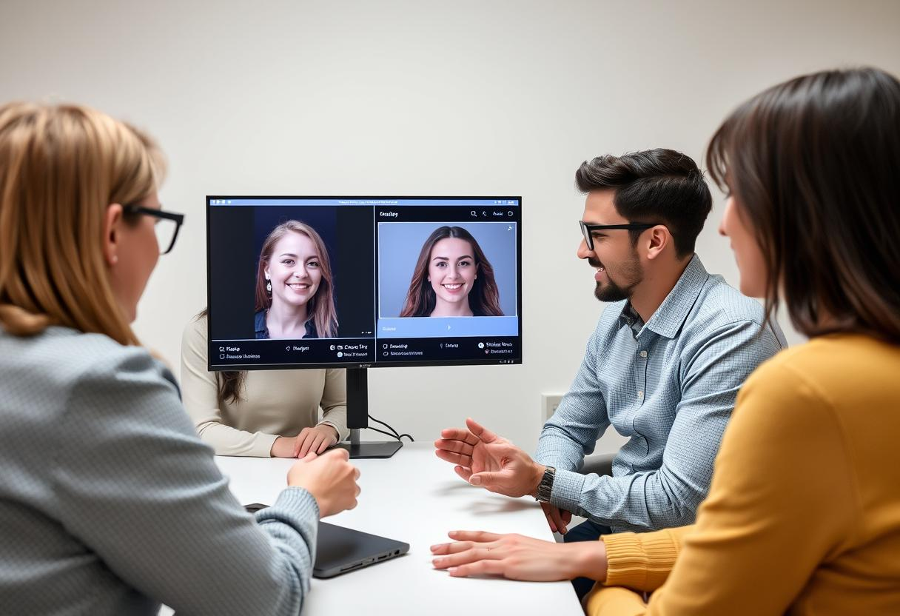
Round 2: Iterative Testing (Refined Design)
Objective: Refine based on Round 1 feedback, testing improvements.
Focus Areas:
Clearer Results: Make confidence scores and results more understandable.
Simplified Navigation: Improve the flow based on previous feedback.
Advanced Features Usability: Test heatmaps and report downloads.
Key Tasks:
Upload media.
View updated results and confidence score.
Interact with the breakdown of results (e.g., heatmap).
Simplified report download.
Metrics:
Task Success Rate: Measure improvements in task completion.
Time to Complete: Measure faster task completion.
User Satisfaction: Feedback on refined design.
Expected Outcome:
Round 1 identifies usability issues.
Round 2 tests refinements and improvements.

Slide 21
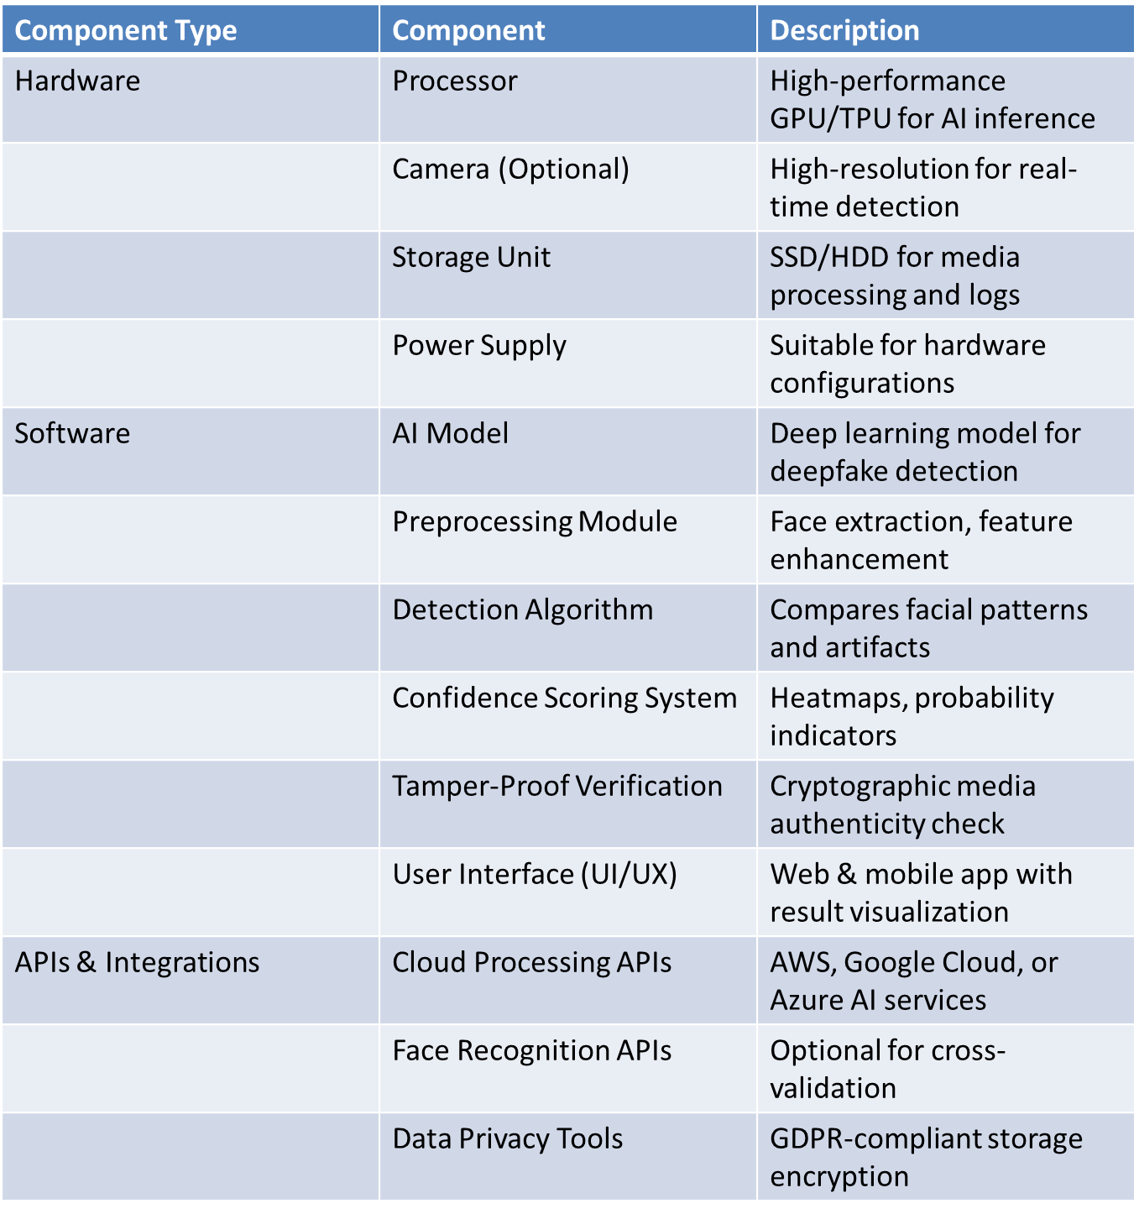
Development stack

Slide 22
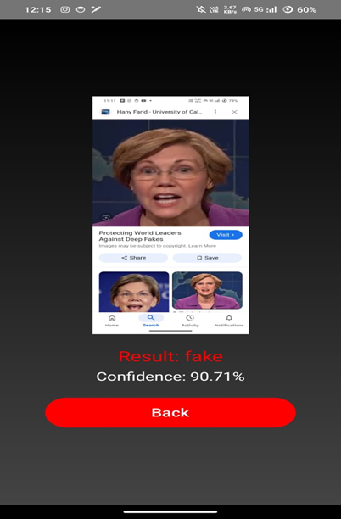
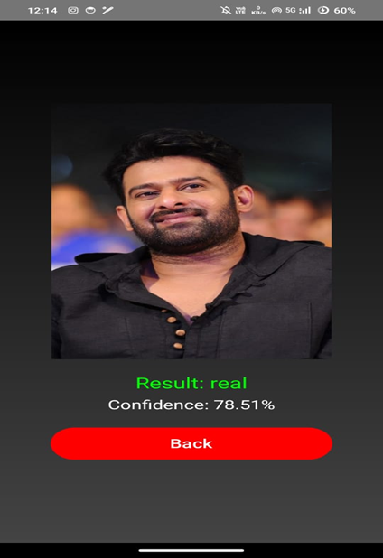
Product Design Hi Fidelity output screen

Slide 23
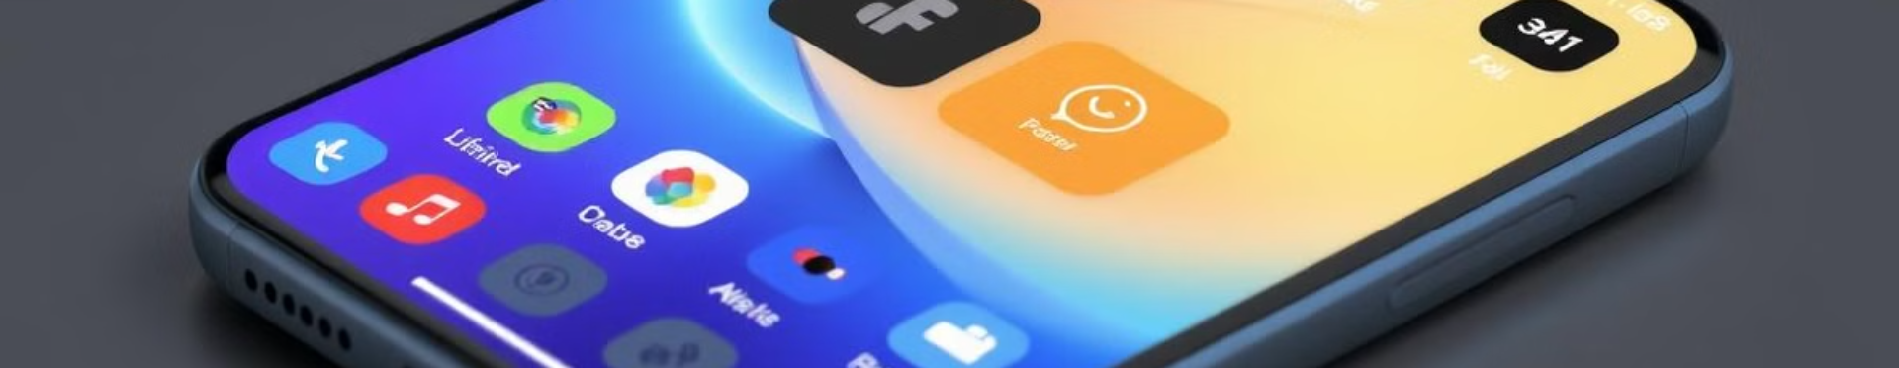
Product Design Mockups
Sample Product
Packaging
Branding
UI mockups for upload, detection results, and report download.
Minimalist box design (if hardware involved),securecasing, and manual.
Logo, color scheme, typography, and marketing assets (website, banners, videos)

Slide 24
Project Learning
Project Impact
Enhanced Deepfake Detection
Helps identify AI-generated media, increasing trust in digital content.
User-Friendly Interface
Simplifies complex AI detection for non-technical users.
Security & Ethical Impact
Supports law enforcement, media, and organizations in combating misinformation.
Market Potential
Useful for social media platforms, forensic analysis, and identity verification systems.
What I Learned
UI/UX Matters
A clean and intuitive interface makes AI-powered tools more accessible.
Balancing Accuracy & Performance
Higher accuracy models may require more processing power, affecting speed.
Importance of User Feedback
Iterative testing helps refine detection explanations and result clarity.
Ethical Considerations
Transparency in deepfake detection results is crucial to avoid false positives.

Slide 25
Product Design Patent link:
patent doc 192210520.docx
Unique Patent Features
Draft Patent Proposal
AI Deepfake Detection – Identifies manipulated media using neural networks.
Confidence Scoring & Heatmaps – Provides transparent anomaly visualization.
Real-Time & Adaptive Learning – Improves accuracy over time.
Tamper-Proof Verification – Uses cryptographic methods for authenticity.
Multi-Format Analysis – Supports images, videos, and live streams.
Title:AI-Based Deepfake Detection and Verification System
Abstract:An AI-driven system for detecting deepfake media with confidence scoring, heatmap visualization, and cryptographic verification to ensure authenticity and prevent misinformation.
Claims:
AI model for deepfake detection.
Confidence scoring and anomaly heatmaps.
Cryptographic verification for authenticity.
Real-time and adaptive learning framework.
Multi-format detection (images, videos, live streams).

Slide 26
Next Steps for Deep Fake Face Detection
Step A: Prototype Development
Finalize UI/UX and core AI model.
Implement real-time detection and reporting features.
Conduct initial internal testing.
Step B: Usability & Performance Testing
Gather user feedback through pilot studies.
Optimize detection accuracy and processing speed.
Improve explainability and transparency in results.
Step C: Deployment & Scaling
Develop API for enterprise integration.
Optimize cloud and on-device deployment options.
Prepare for market launch (pricing, branding, and distribution).
Step D: Compliance & Industrial Approvals
ISO 27001 – Information security management.
ISO 9001 – Quality management systems.
ISO 29119 – Software testing standard.
ISO 22301 – Business continuity and risk management.
GDPR & CCPA Compliance – Data privacy regulations.
CE/FCC Certification – If hardware components are involved.

Slide 27


Email ID : pothulavenkatavishnuvardhan0520.sse@saveetha.com
P venkata vishnu vardhan 192210520

